Slide 1
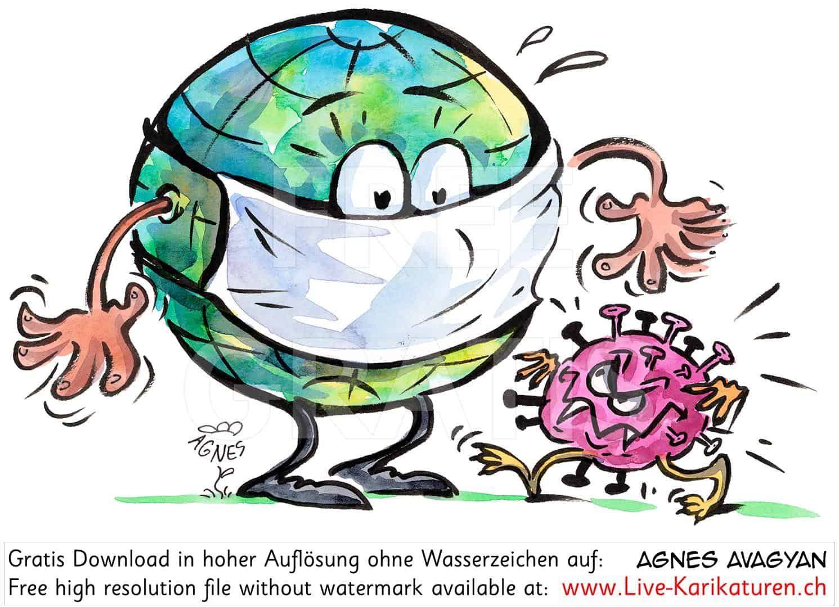

Case Study
COVID ANALYSIS
Alex The Analyst
SQL
Data Exploration Project
- Syed Sarfaraz Ahmed / Data Analyst

Slide 2
INTRODUCTION
This project delves into the Covid-19 situation spanning from January 2020 to April 2021, utilizing two primary datasets named "CovidDeaths" and "CovidVaccination“.
Through rigorous SQL analysis, this endeavor aims to provide a holistic understanding of the pandemic's impact by examining the interplay between Covid-related fatalities and the progress of vaccination efforts. This report encapsulates the key findings, trends, and insights derived from the data exploration, shedding light on the evolving landscape of the pandemic during the specified timeframe.

Slide 3
SUMMARY OF ANALYSIS
Looking at total cases vs total deaths.
Looking total cases vs Population. Show what percentage of population got Covid.
Looking at Regions with highest infection rate compared to population.
Showing Regions with highest Death count per Population.
Global Numbers.
Positivity rate per region daily.
Creating Views for Data Visualization.

Slide 4
ENTITY RELATIONSHIP DIAGRAM
CovidDeaths
Location | VARCHAR()
Population | INTEGER
new_cases | NVARCHAR()
Total_deaths | NVARCHAR()
*
CovidVaccinations
Location | VARCHAR()
Population | INTEGER
new_vaccinations | NVARCHAR()
Total_vaccinations | NVARCHAR()
*

Slide 5
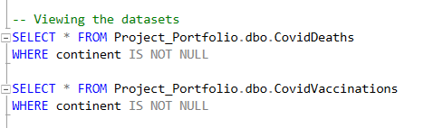
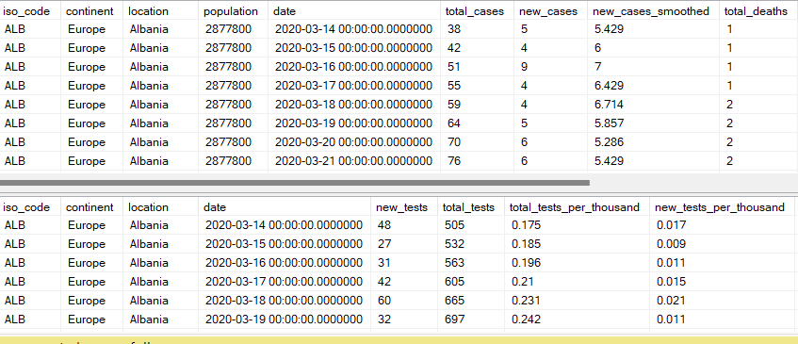

Slide 6
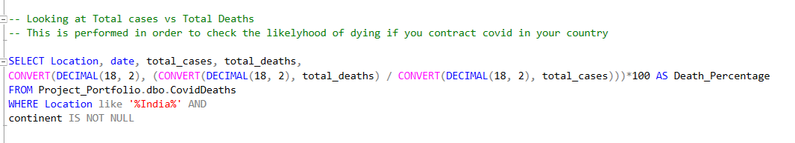
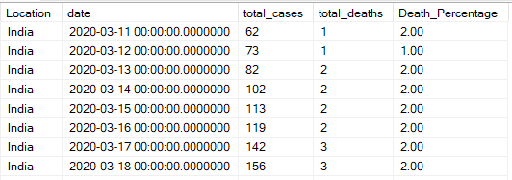

Slide 7
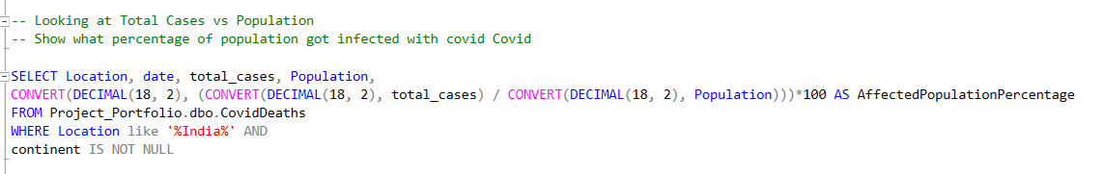
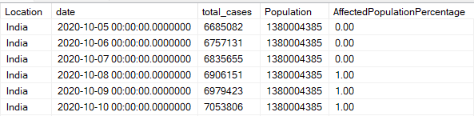

Slide 8
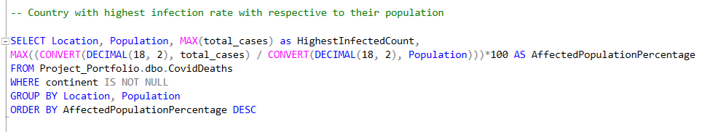
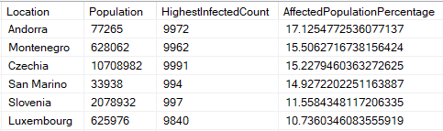

Slide 9
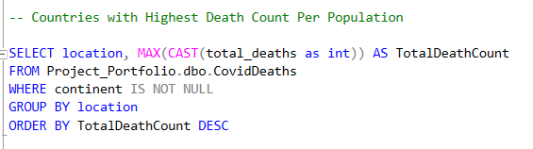
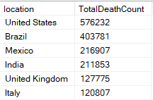

Slide 10
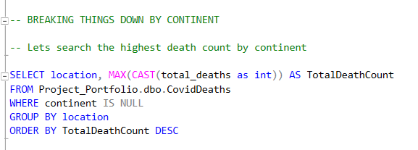
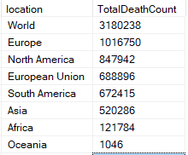

Slide 11
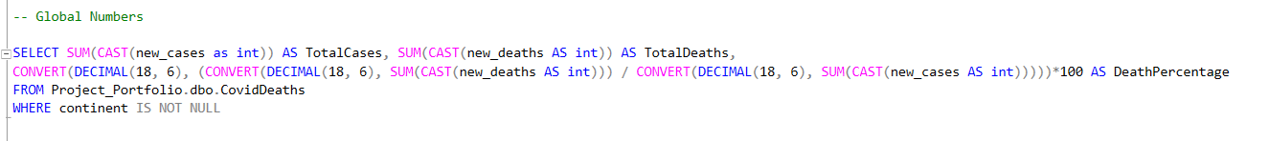


Slide 12
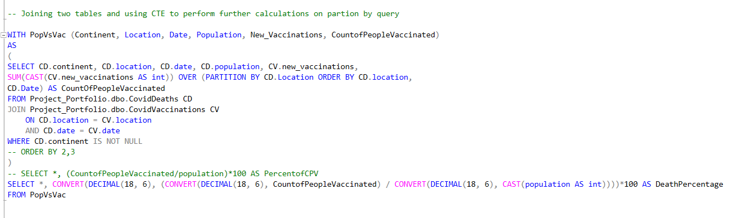
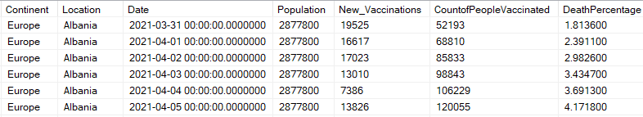

Slide 13
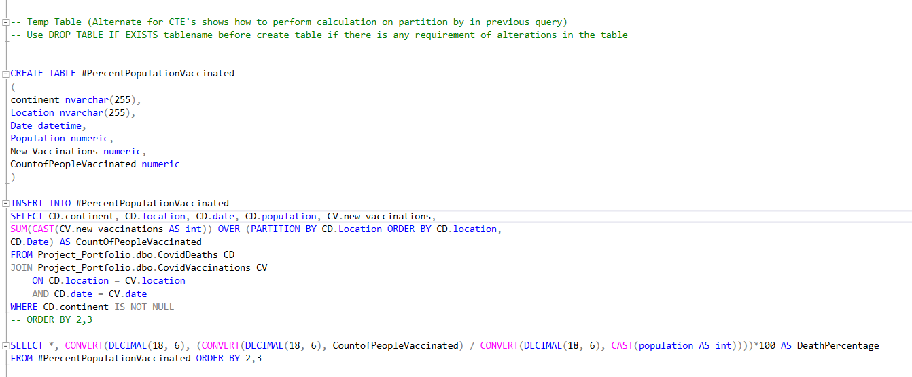

Slide 14
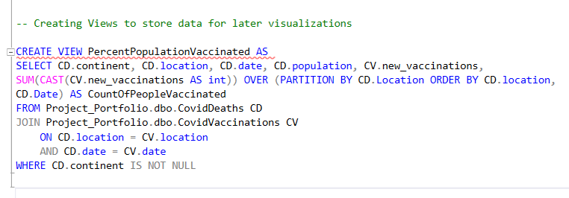
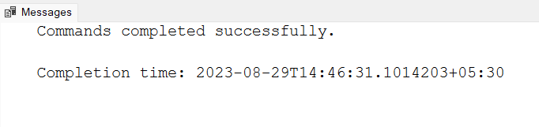

Slide 15
Thank You!

